Slide 1

Keystroke Logging Demonstration
(For educational simulation)
Made by Jai Rane

Slide 2

PROBLEM STATEMENT
With the rapid growth of digital systems, users frequently enter sensitive information such as passwords and personal data through keyboards.
Keyloggers are malicious tools that can secretly record keystrokes, leading to serious security and privacy threats.
This project aims to study keyloggers, their working mechanism, and the importance of preventive measures.

Slide 3
Project Description
A keylogger is a software or hardware tool that records keystrokes made on a keyboard. These keystrokes may include usernames, passwords, and messages.
Keyloggers are commonly used by attackers for data theft but may also be used for legitimate purposes such as system monitoring with user consent.
This project demonstrates keylogging in a controlled environment and explains system-wide keylogging conceptually under academic guidance.

Slide 4

WHO ARE THE END USERS?
Cybersecurity & Computer Science Students
Ethical Hackers (educational purpose)
IT & System Administrators
Security Analysts
Software Developers
Educational Institutions
General Users/Common People (for raising awareness)

Slide 5

Technology Used
Programming Language: Python
Software: VS Code Editor
GUI Library: Tkinter
Operating System: Windows
Data/Logs Stored: In ‘.txt’ format (Text File Logging)

Slide 6
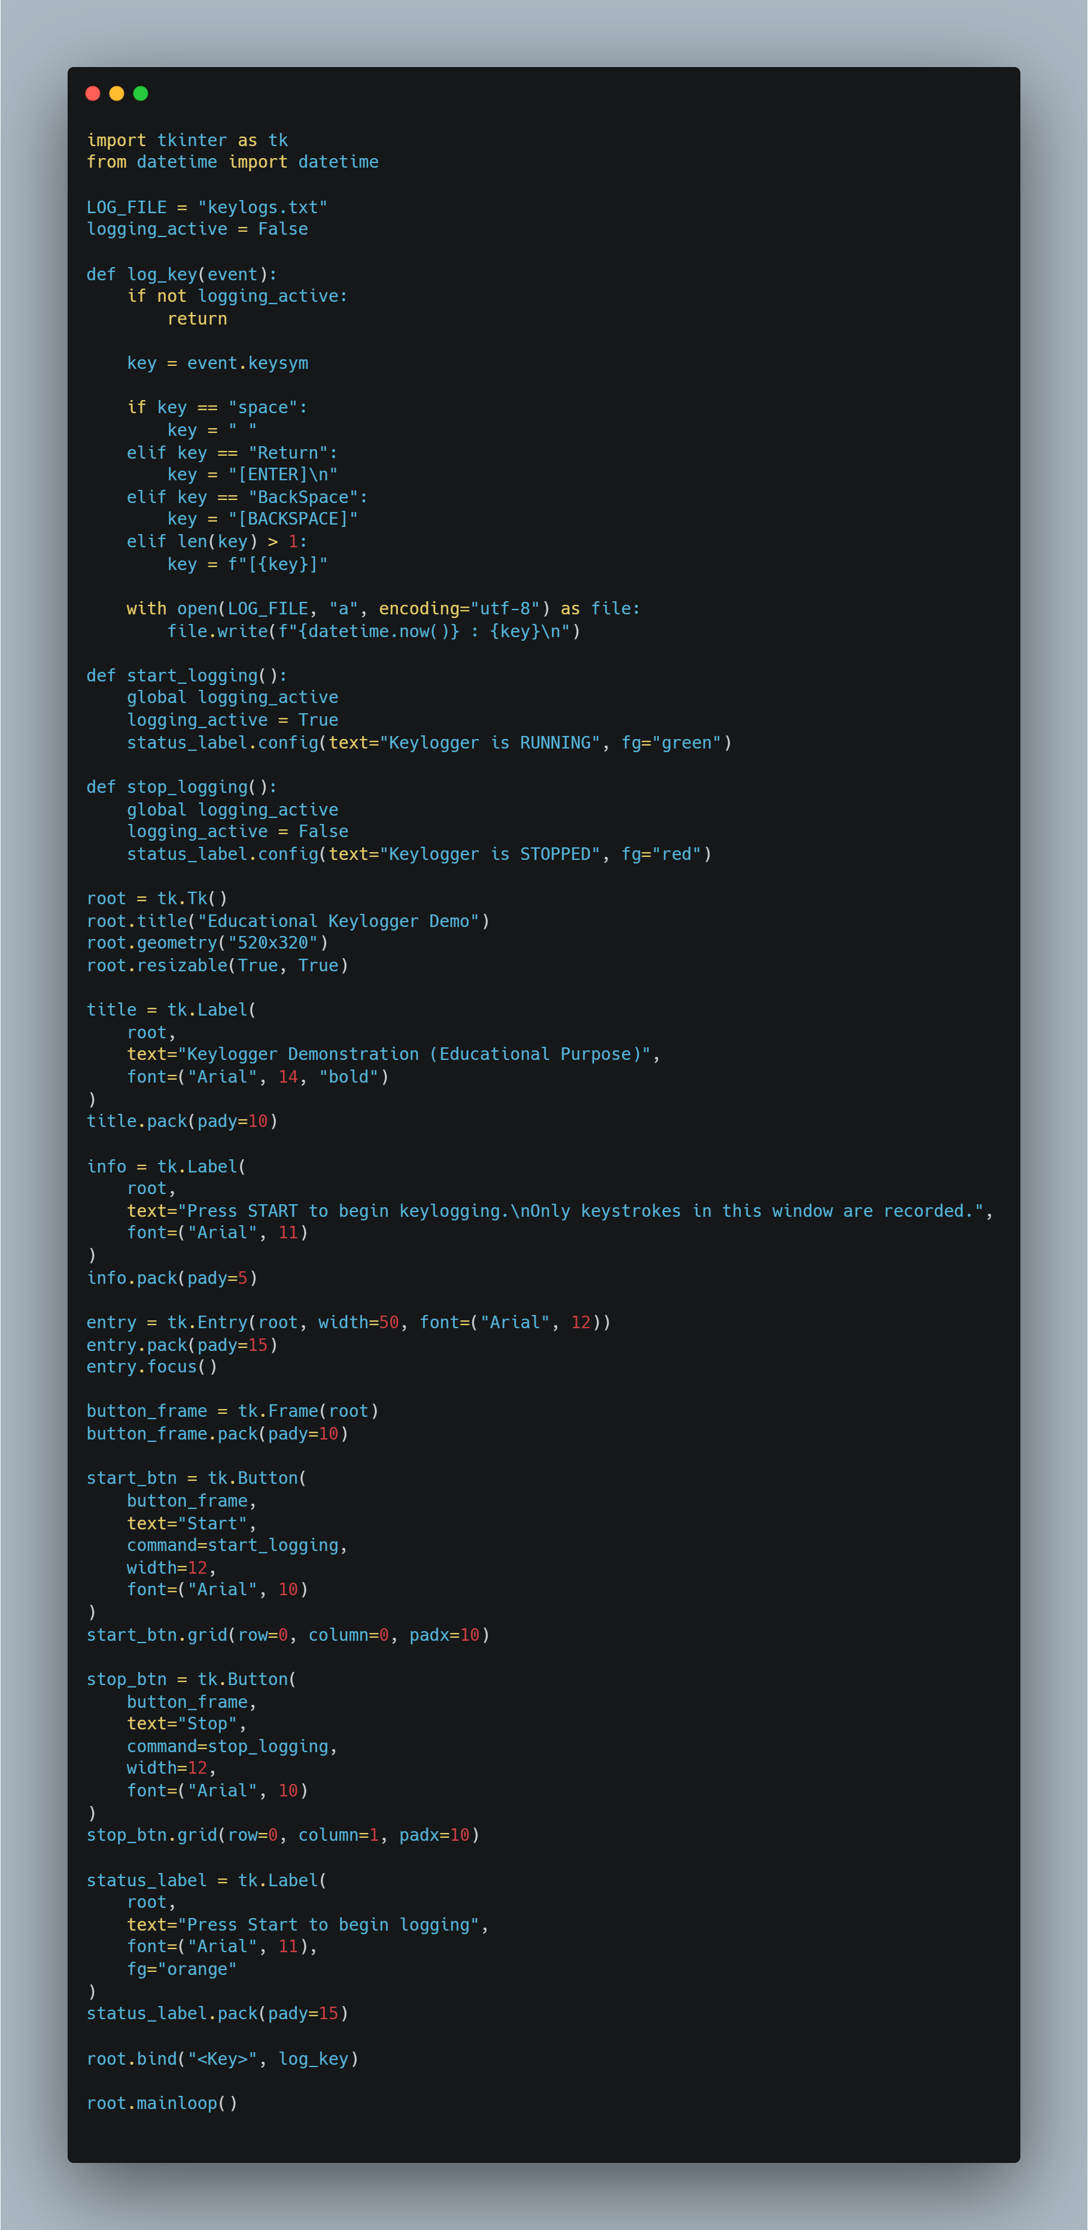
RESULTS
Snippet 1

Slide 7
RESULTS
Snippet 2

Slide 8
RESULTS
Final Snippet

Slide 9
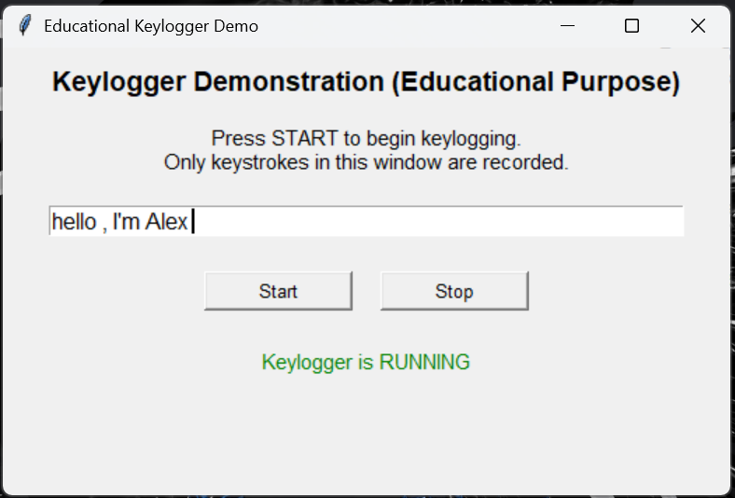
RESULTS
Output of
Python Code

Slide 10
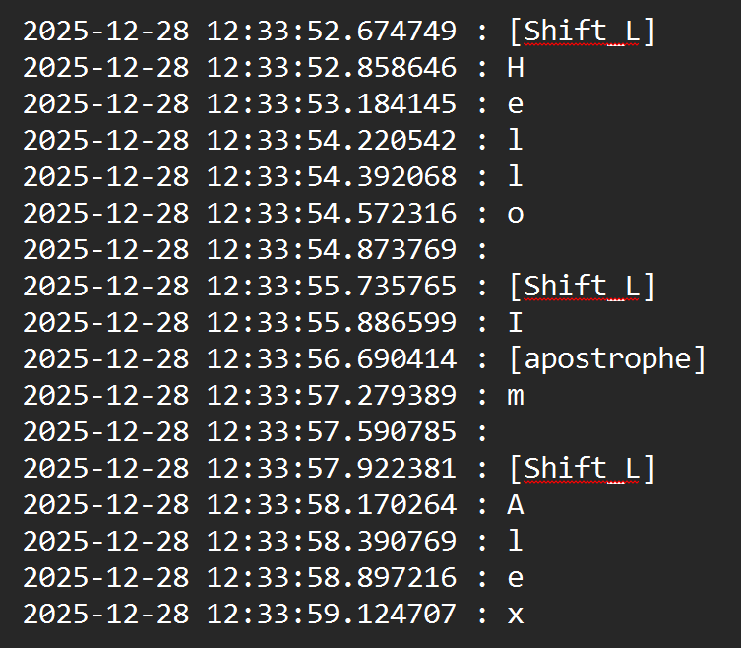
RESULTS
Logs stored
In Txt File

Slide 11
RESULTS
Github Repository for this project :
https://github.com/ranejai954/vois-cybersecurity-genai-internship/tree/main/build

Slide 12
Thank you
.

